Slide 1
Smart cooker whistle counter with auto shut-off
NAME: TELAPOLU MANI SAI LOKESH
DEPT: AI&DS
REGNO: 192224105
SUPERVISOR : Dr. Arjun Pandian

Slide 2
Product Problem:
A Smart Cooker Whistle Counter with Auto Shut-Off faces challenges like accurate whistle detection due to background noise, requiring advanced sensors. Compatibility issues arise with different pressure cookers and stove types, demanding adaptable designs. Safety concerns include false shut-offs, necessitating dual-sensor verification for reliability. Power supply and connectivity limitations may affect performance, so offline functionality and manual override options are essential. Market acceptance depends on user-friendly interfaces and educating consumers about the benefits of automation in cooking.
Solutions:
For accurate detection of whistles, sensors that are high-grade with noise cancelation and artificial intelligence-based processing can detect whistles independent of background noises. Compatibility with a variety of pressure cookers and stoves types is made necessary by variable sensitivity settings and multiform smart adapters. Reliability and safety would be enhanced with dual-sensor confirmation, synthesizing vibration sensing and audio detection to avoid misfires. Complications arising with power and connectivity are alleviated with battery backup and offline connectivity to ensure operation at all times. To promote user uptake, a user-friendly interface, concise setup process, and well-executed demonstrations can make the product more enjoyable and convenient.

Slide 3
Product domain study
SUMMARY
A Smart Cooker Whistle Counter with Auto Shut-Off belongs to the smart kitchen appliances category, combining IoT, sensor technology, and automation to optimize cooking efficiency. The device is designed to address problems associated with manual whistle counting, overcooking, and safety issues through automated shut-off. The major technological elements involve sound and vibration sensors, microcontrollers (Arduino/Raspberry Pi), AI-based noise filtering, and smart relays for heat control. Market adoption relies on ease of use, compatibility with different cookers and stoves, affordability, and consumer trust. Future developments may include mobile app connectivity, voice assistant integration, and real-time monitoring for improved user experience. The product meets the increasing demand for smart home automation, meeting users looking for convenience and energy savings when cooking, and with the need for automated kitchen solutions increasing, it has immense potential in the household and business markets.
Article Link:

Slide 4
Product domain study
LINKEDIN ARTICLE:
ARTICLE:
CONCLUSION
The Smart Cooker Whistle Counter with Automatic Switch-Off is a new game-changer in the world of cooking, bringing convenience, precision, and safety into the cooking process. The automation of whistle counting and controlling heat allows one to avoid the risk of overcooking and minimize energy wastage. With this product, busy households and individuals can be assured of a safer way of cooking in just less time and effort. With its user-friendly design and enhanced functionality, it is poised to revolutionize the way we cook, offering a perfect blend of technology and practicality for every kitchen.

Slide 5
Problem Statement
Traditional pressure cookers require constant attention to count whistles and manually switch off the heat, which can result in overcooking or burning food. This process is time-consuming and increases the risk of accidents. For individuals with busy schedules, it becomes difficult to monitor cooking while managing other tasks. Therefore, there is a need for a smart cooker that automatically counts whistles and turns off the heat, ensuring precise cooking and enhanced safety.The absence of automation in whistle counting also makes it difficult for individuals with busy schedules or disabilities to monitor cooking effectively. A smart system integrating sensor-based whistle detection and auto shut-off can enhance efficiency, reduce manual effort, and promote energy conservation.

Slide 6
Project Scope
My Roles:
Product Research & Development – Identify market needs and develop a functional prototype.
Technology Integration – Implement sensors, microcontrollers, and automation features.
Testing & Optimization – Ensure accuracy, reliability, and compatibility.
User Experience Design – Develop an intuitive interface and control system.
Safety & Compliance – Ensure adherence to safety standards and risk minimization.
Market Strategy – Plan pricing, positioning, and consumer adoption strategies.
Future Enhancements – Explore new features like real-time monitoring and voice integration.
Responsibilities:
Developing and Prototyping – Design, build, and refine the smart cooker whistle counter system.
Integrating Sensor Technology – Implement sound and vibration sensors for accurate whistle detection.
Ensuring System Accuracy – Optimize algorithms to prevent false detections and improve reliability.
Testing and Validation – Conduct real-world testing to ensure proper functionality across different cookers and stoves.
User Interface Design – Create an intuitive control system for ease of use.
Safety and Compliance – Ensure the product meets safety regulations and minimizes risks.
Market Research and Adoption – Analyze consumer needs and improve the product for better adoption.
Continuous Improvement – Innovate and explore additional features like mobile connectivity and voice assistant integration.

Slide 7
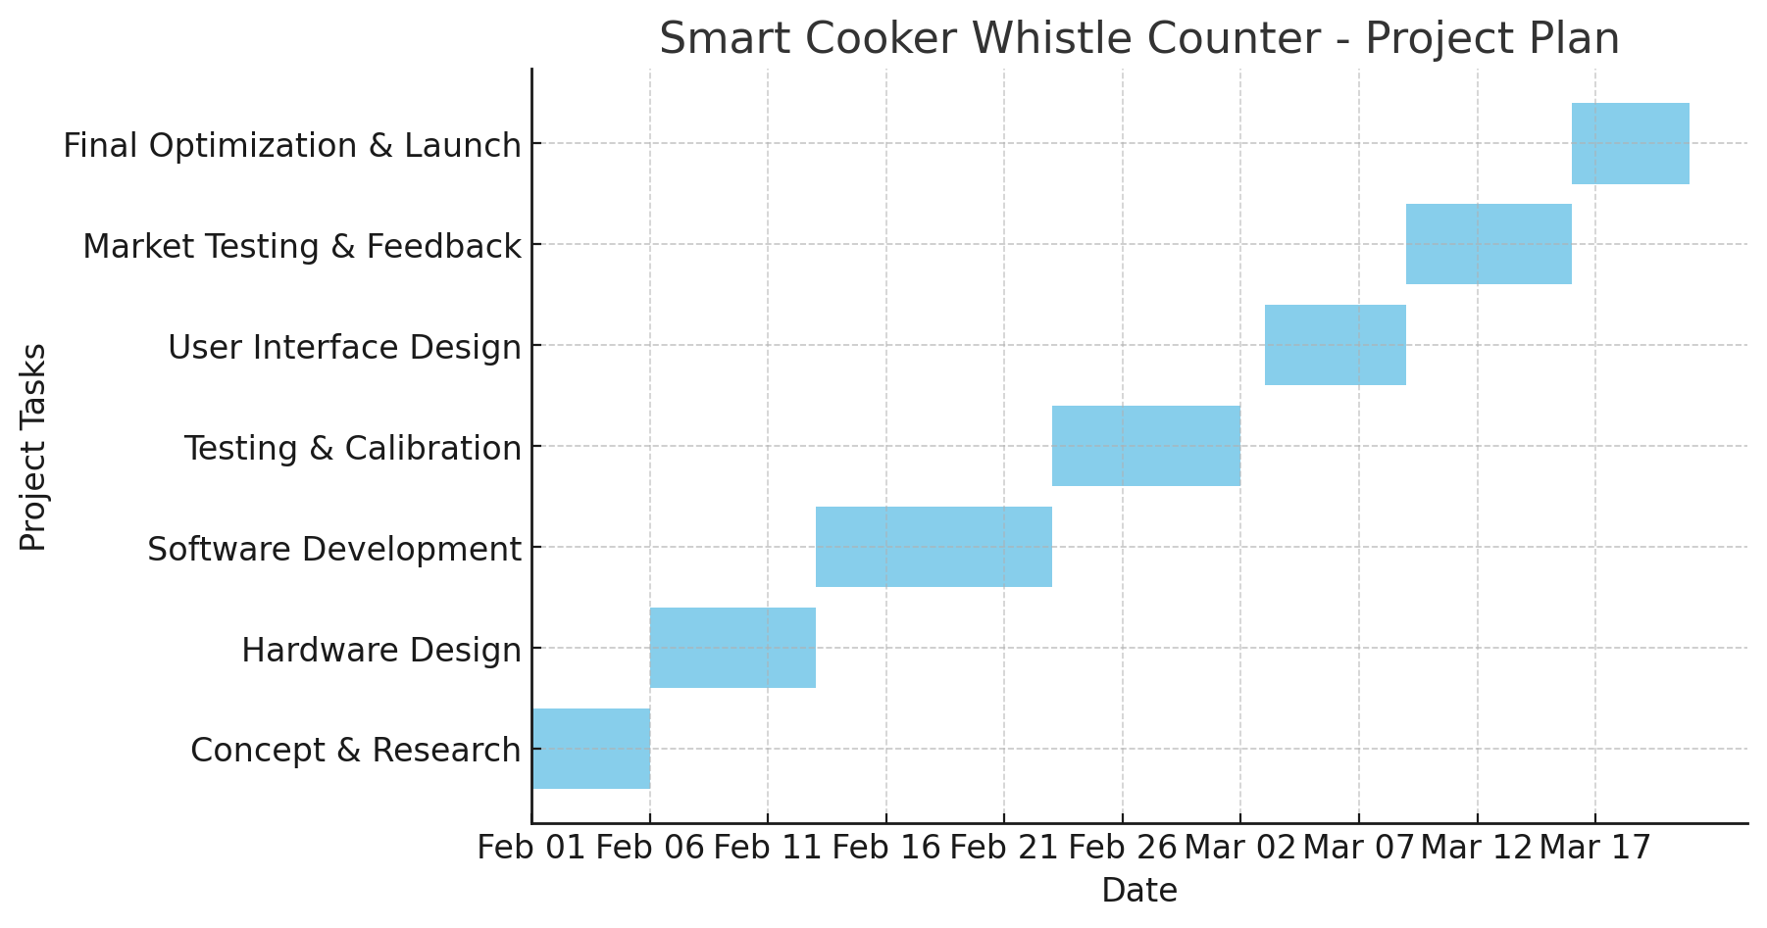
Project Plan

Slide 8
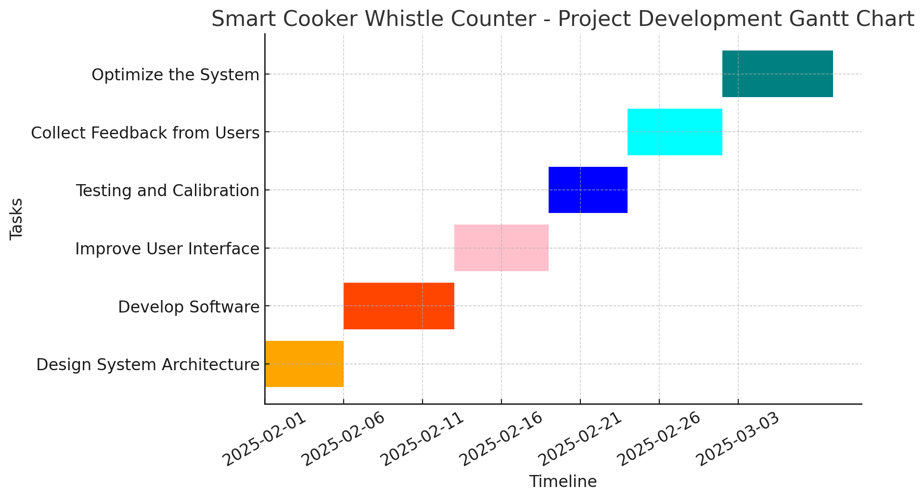
Project Timeline

Slide 9

8. Pain Points:
Often gets distracted while cooking, leading to overcooked or undercooked meals.
Finds traditional cookers outdated and inefficient.
Prefers a solution that integrates with smart home automation.
9. Motivations:
Interested in smart technology solutions for everyday tasks.
Values convenience, efficiency, and safety in the kitchen.
Prefers user-friendly and tech-enhanced home appliances.
10. Behavior Patterns:
Prefers quick cooking methods due to a busy lifestyle.
Actively researches and adopts new tech-based solutions.
Shares experiences and reviews on online forums and social media.
User Persona
6. Background & Lifestyle:
Works in an IoT-based startup, specializing in automation solutions.
Loves experimenting with smart home technologies.
Prefers quick and efficient cooking due to a busy work schedule.
7. Goals & Needs:
Needs a smart cooking assistant that reduces manual effort.
Prefers an automated system that ensures consistent food quality.
Wants an energy-efficient and safe cooking solution.
1. Name: suresh
2. Age: 25 years
3. Occupation: Embedded Systems Engineer
4. Education: Bachelor's Degree in Electronics and Communication Engineering (ECE)
5. Hometown: Bengaluru, India

Slide 10
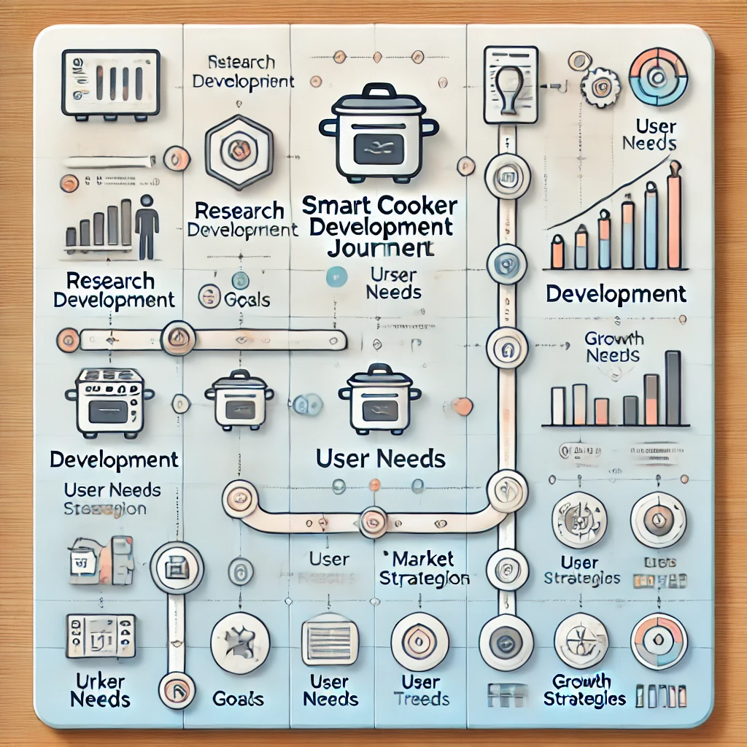

Product Developer Journey

Slide 11
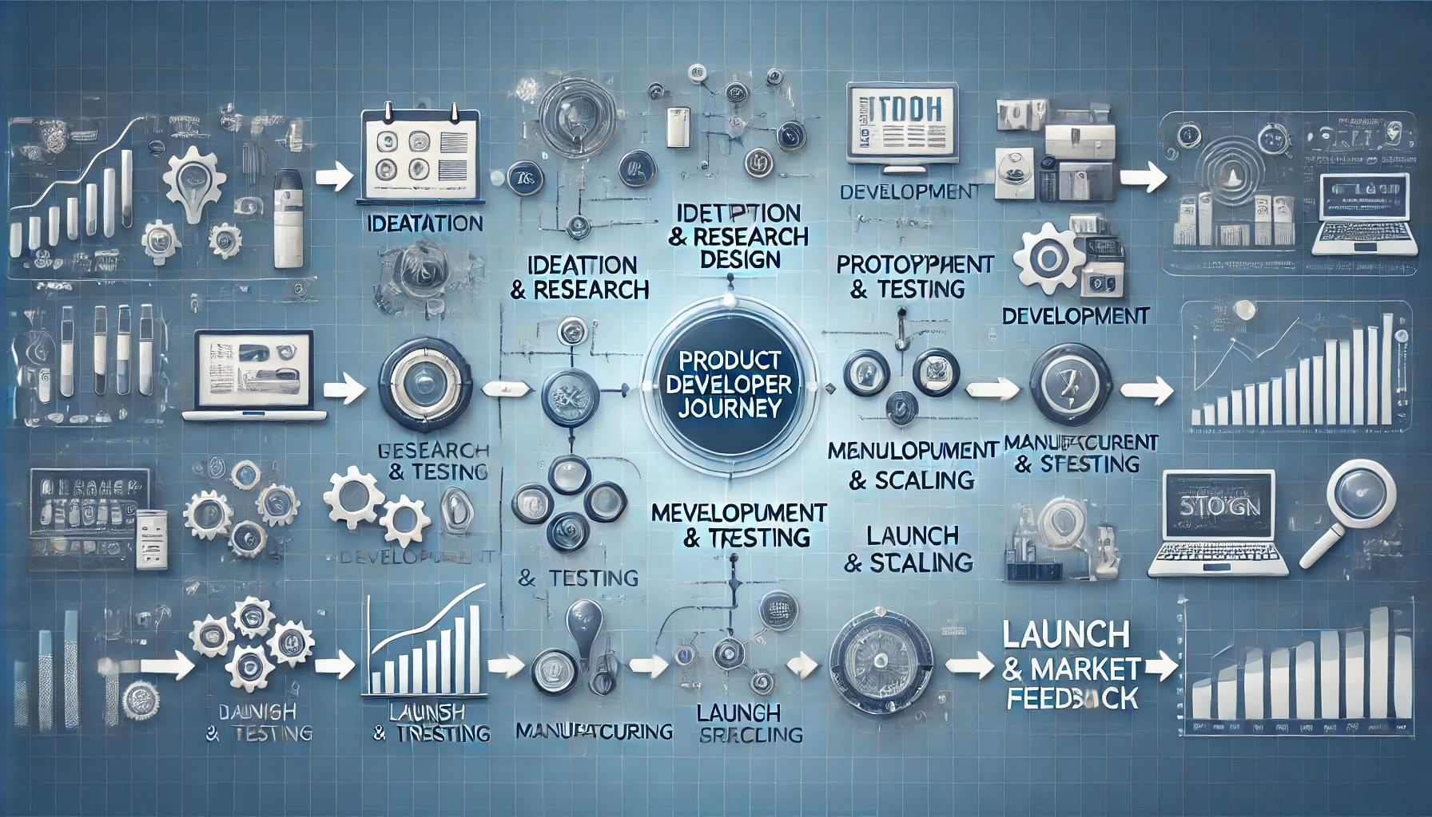

Slide 12
Competitive analysis
Competitor Name | Price | Target Audience | Unique Value Proposition | Components | Component Price
Whistle Track Pro | ₹ 3,500 | Home Cooks, Chefs | High-accuracy whistle detection with mobile app sync. | Microphone Sensor, Buzzer, LCD Screen | ₹ 1,200
CookSense Mini | ₹ 2,800 | Small Families | Compact design with LED alerts for whistle counting. | Sensor, Buzzer, Switches | ₹ 900
Auto Whistle Max | ₹ 4,200 | Restaurants, Hotels | AI-based whistle tracking with customizable alerts. | Relay Module, Microphone Sensor, LCD Screen | ₹ 1,500
Smart Cooker Whistle Counter | ₹ 2,500 | Home Users, Cooking Enthusiasts | Affordable, easy-to-use, and ensures perfect cooking every time. | Relay Module, Microphone Sensor, Switches, Buzzer, LCD Screen | ₹ 1,100

Slide 13
Business Potential
GAP ANALYSIS
TARGET AUDIENCE
MARKET SIZE
Traditional pressure cookers lack automatic whistle counting, leading to overcooked or undercooked food.
Users need to manually monitor cooking, which is inconvenient and error-prone.
Demand for an affordable, smart solution with real-time alerts and automation.
Home cooks, working professionals, and elderly individuals who need precise cooking assistance.
Restaurants and catering businesses that require accurate cooking time management.
The smart kitchen appliances market in India is estimated to grow significantly, reaching ₹5,000+ crore by 2025. SOURCE: INDUSTRY REPORT 2023
The global smart kitchen market is projected to grow from USD 15 billion in 2023 to USD 30 billion by 2030, with a CAGR of 9.2%. SOURCE: MARKET RESEARCH 2023
UNIQUENESS
Automatically counts cooker whistles and alerts users via buzzer and display.
Can be integrated with mobile apps for real-time monitoring.
Ensures consistent cooking results with minimal supervision.

Slide 14
User Pain Points
PAIN POINTS
🔴 Manual Monitoring Hassle: Traditional pressure cookers require users to manually count whistles, leading to inconsistencies in cooking.
🟠 Overcooking & Undercooking Risks: Without precise tracking, food may be overcooked or undercooked, affecting taste and texture.
🟡 Limited Automation: Most pressure cookers lack smart features like automatic whistle counting, real-time alerts, or integration with other devices.
🟠 User Dependence: Cooking requires constant attention, making it inconvenient for busy individuals and elderly users.
Lack of Smart Alerts & Display: Traditional cookers do not have an LCD screen to show real-time cooking status, countdowns, or alerts.
🔵 No Automated Control: Without a relay module, users cannot automate switching off the stove based on whistle count, leading to energy wastage.
🟣 No Audio Notifications: The absence of a buzzer means users must stay nearby to hear the whistles, making multitasking difficult.

Slide 15
G - Gap Analysis (Market Gap)
Existing Market Gaps in Traditional Cooking Solutions
Manual Cooking Challenges:
🔴 Traditional pressure cookers require constant manual supervision, making cooking inconvenient and time-consuming. 🔴 Users often face challenges in counting whistles accurately, leading to inconsistent cooking results and affecting food quality. 🔴 Increased gas or electricity wastage due to the lack of an automatic switch-off feature. 🔴 Safety concerns arise due to the risk of overcooking or overheating in traditional cookers.
Limitations of Existing Smart Cookers:
🟠 High-cost smart cookers make automation inaccessible for many households. 🟠 The market currently offers limited smart cooking solutions that integrate whistle counting technology, leaving a gap in automation for precise cooking. 🟠 Complex user interfaces make them difficult for non-tech-savvy users.
Market Need for an Innovative Solution
✔️ Affordable Smart Cooking – Households and small restaurants seek cost-effective automation. ✔️ Precise & Hassle-Free Cooking – Automated whistle detection ensures consistent results. ✔️ Energy-Efficient & Safe – Auto switch-off prevents overheating, reducing electricity and gas consumption.
Key Opportunity:
A cost-effective, user-friendly, and smart whistle-counting cooker with an auto switch-off feature that automates cooking, enhances safety, reduces energy wastage, and ensures precision without constant supervision.

Slide 16
P - Product (Description, Overview)
Overview of the Smart Cooker Whistle Counter
The Smart Cooker Whistle Counter is an innovative kitchen solution designed to enhance convenience, precision, and safety in pressure cooking. This system automates whistle counting and integrates an auto switch-off feature, ensuring perfectly cooked meals while reducing manual effort and energy consumption.
Key Features:
✅ Automated Whistle Counting – Accurately detects and counts whistles for precise cooking. ✅ Auto Switch-Off – Turns off heat automatically after the required whistles, preventing overcooking. ✅ User-Friendly Interface – Simple controls for easy operation, even for beginners. ✅ Multi-Recipe Compatibility – Supports various cooking settings for different dishes. ✅ Energy Efficiency – Reduces electricity usage by stopping heat at the right time. ✅ Safety Features – Prevents overheating, reducing risks of accidents in the kitchen.

Slide 17
Applications:
🏭 Electrical & Electronics Industry – Cutting wires for circuit boards and electrical panels. ⚙️ Manufacturing & Automation – Mass production of uniform wire lengths. 🔬 DIY & Prototyping – Hobbyists and small businesses needing precision cuts. 🚗 Automotive & Aerospace Wiring – Precision-cut wires for harnesses and electrical systems.
💡 Why Choose the Smart Cooker Whistle Counter?
✅ Hands-Free Cooking – No need for constant supervision; ensures perfect cooking. ✅ Consistent & Precise Results – Automatically counts whistles for accurate cooking. ✅ Enhanced Safety – Prevents overcooking and overheating with an auto switch-off feature. ✅ Energy-Efficient – Reduces gas and electricity usage, saving on utility costs. ✅ User-Friendly & Affordable – Smart automation at a budget-friendly price.

Slide 18
COMPARISON
Criteria | Traditional Pressure Cooker | Smart Cooker Whistle Counter with Auto Switch-Off
Whistle Counting | Manual, prone to errors | Automated and accurate whistle detection
Cooking Monitoring | Requires constant supervision | Hands-free operation with automatic alerts
Cooking Accuracy | Inconsistent, due to manual counting | Consistent and precise cooking results
Safety | Risk of overcooking and overheating | Auto switch-off ensures safe operation
Energy Efficiency | High energy consumption without control | Energy-efficient with automatic switch-off
User Convenience | Time-consuming and inconvenient | User-friendly and hassle-free operation
Technology Integration | No smart features | Advanced whistle counting and automation
Market Availability | Widely available | Limited availability in smart cooking solutions

Slide 19
U - Uniqueness of Your Project
Key Unique Features
🔹 💡 Fully Automated Whistle Detection & Smart Control – No manual counting, ensuring precision. 🔹 ⚙️ Customizable Cooking Settings – Set whistle count preferences for different recipes. 🔹 💰 Affordable & Energy-Efficient Solution – Reduces gas and electricity wastage. 🔹 🛡️ Enhanced Safety with Auto Shut-Off – Prevents overcooking and overheating. 🔹 🌍 Versatile & User-Friendly Design – Suitable for all pressure cookers, making cooking effortless.
The Smart Cooker Whistle Counter with Auto Shut-Off revolutionizes traditional pressure cooking by automating whistle counting and ensuring precise cooking results. It features a microphone sensor for accurate whistle detection, a buzzer for completion alerts, an LCD display, and an auto shut-off mechanism to enhance safety, convenience, and energy efficiency. This smart solution eliminates manual supervision, prevents overcooking, and optimizes resource usage, making cooking effortless and reliable.
Final Thought 💭
With its smart automation, affordability, and precision, the Smart Cooker Whistle Counter with Auto Shut-Off is set to revolutionize pressure cooking, making it more convenient, safe, and efficient for households and cooking enthusiasts alike!

Slide 20
Flowchart of Operation
+---------+ +------------------+ +----------------+ +-----------------+ +----------------------+
| Start |→| Add Ingredients| →| Set Whistle | →| Detect Whistle| → | Auto Shut-Off |
| | | & Water | | Count | | with Sensor | | |
+---------+ +------------------+ +----------------+ +-----------------+ +----------------------+
↓
+------------------+ +------------------+ +-----------------+ +------------+
| Cooking Done | → | Alert with | → | Release Steam| → | End |
| | | Buzzer & LCD | | if Needed | | |
+------------------+ +------------------+ +-----------------+ +------------+

Slide 21
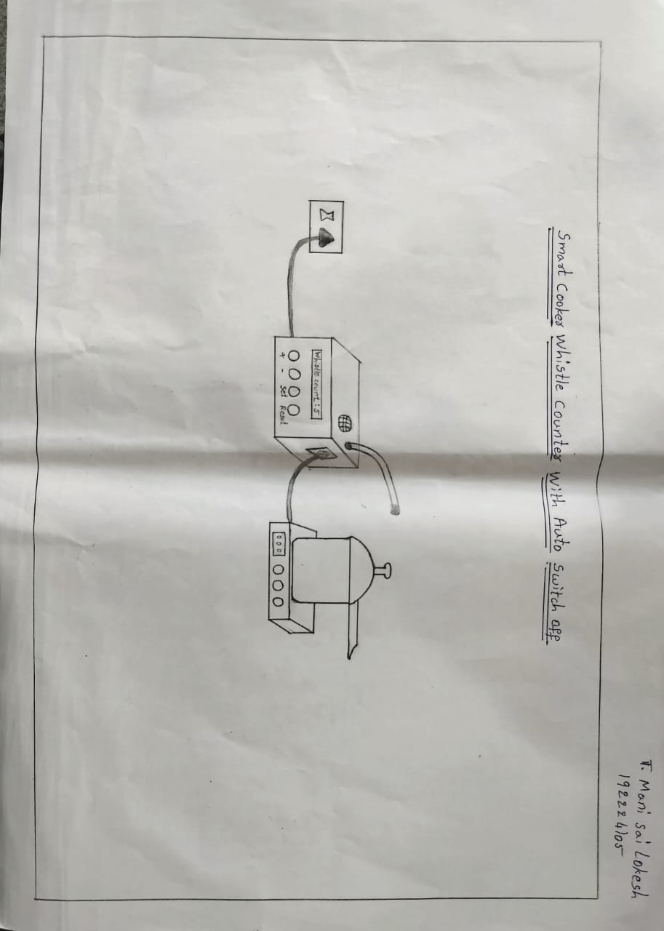
2D Product Sketches

Slide 22
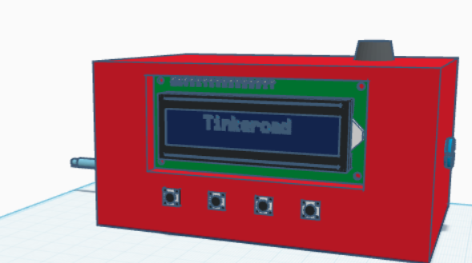
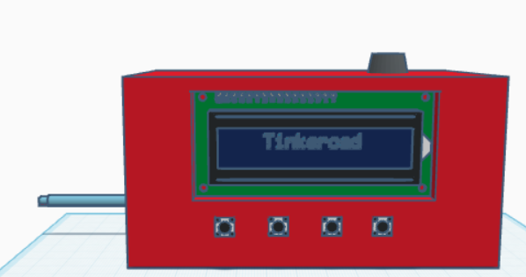

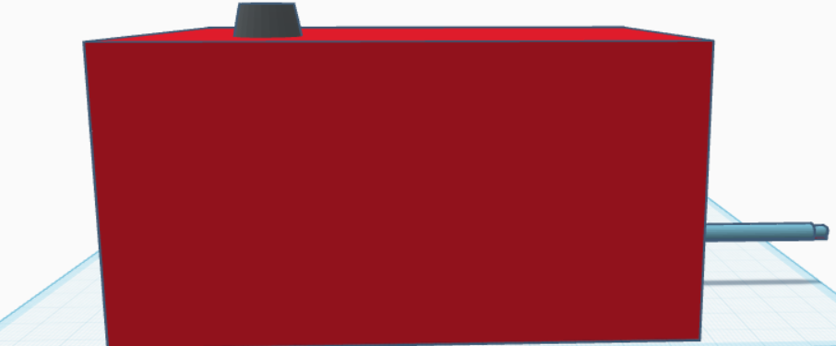
3D Product Sketches

Slide 23
List of Components
Arduino Board – Acts as the microcontroller to process sensor inputs and control outputs.
Buzzer – Alerts the user when the whistle is detected.
Microphone Sensor – Detects the sound of the pressure cooker whistle.
LCD I2C Display – Displays the count of whistles and system status.
Push Buttons – Used for user input and system reset.
Switch – Allows manual control of the system (ON/OFF).
Boost Converter – Regulates the power supply for stable operation.
Jumper Wires – Connects various components in the circuit.
Relay Module – Controls external appliances based on whistle count.
3-Pin Plug – Provides power connection to the system.
Binding Wire – Used for securing and organizing components.
Boost Converter – Regulates and steps up the power supply for stable operation.

Slide 24
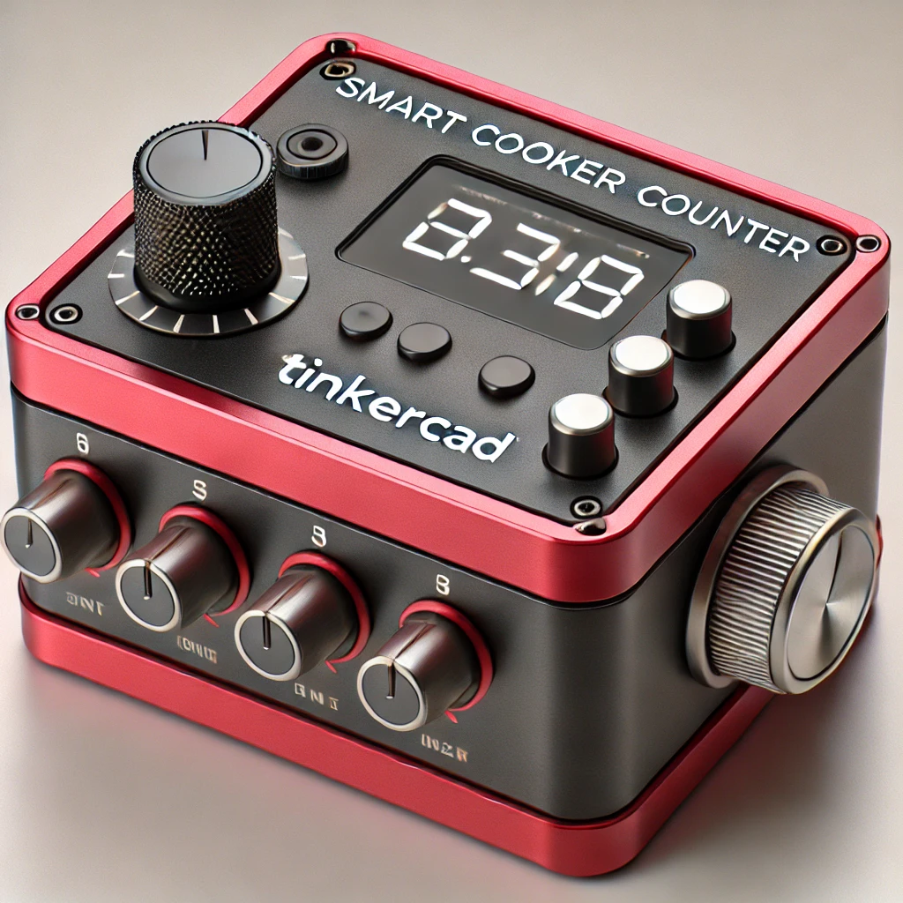
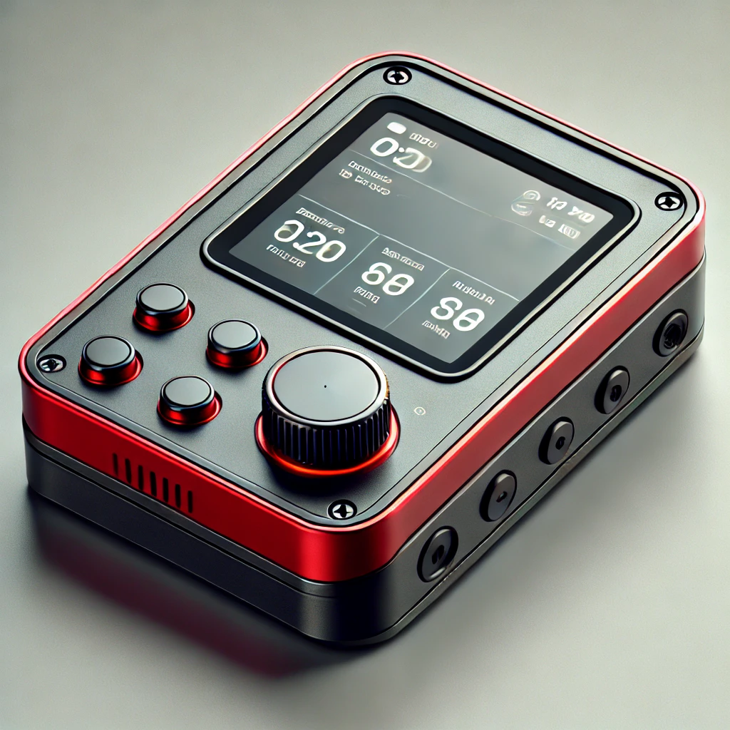
Mockup Design Hi fidelity

Slide 25
Project learning
Project Impact
What I learnt
Enhanced Cooking Efficiency – The Smart Cooker Whistle Counter with Auto Shut-Off eliminates the need for manual whistle counting, ensuring precise cooking.
Convenience & Automation – Users can rely on automated whistle detection and shut-off, reducing supervision time.
Improved Safety – Prevents risks of overcooking, gas wastage, and overheating, making cooking safer.
Smart Home Integration – Potential for future compatibility with IoT and voice assistants for a seamless kitchen experience.
Energy & Cost Savings – Reduces gas or electricity usage by automatically stopping cooking at the right time.
IoT & Sensor Implementation – Worked with microphone sensors, buzzers, and relay modules for whistle detection.
Embedded System Programming – Developed automation logic for whistle counting and shut-off using microcontrollers.
Product Optimization – Enhanced accuracy and efficiency of the system to ensure reliable performance.
User-Centered Design – Focused on ease of use, compatibility with various cookers, and affordability.
Market Research & Feasibility – Analyzed market demand, pricing, and potential consumer adoption of smart cooking solutions.

Slide 26
Product Design Patent
PATENT
Claim: Wherein the system incorporates a microphone sensor to detect whistle sounds, ensuring precise whistle counting for accurate cooking time.
Claim: Wherein the relay module automatically triggers the shut-off mechanism after the desired whistle count, preventing overcooking and enhancing safety.
Claim: Wherein an integrated LCD screen displays real-time whistle count and cooking status, providing users with clear cooking progress updates.
Claim: Wherein the buzzer alert system notifies the user upon reaching the pre-set whistle count, ensuring convenience and efficiency.
Claim: Wherein the system features a calibration mode allowing users to adjust sensitivity levels for different types of pressure cookers, improving compatibility.

Slide 27
Next Steps
Step C: Documentation and Compliance
Step B: Prototyping and Testing
Step A:Product Refinement
Technical Documentation – Create detailed circuit diagrams, wiring instructions, and user manuals.
Regulatory Compliance – Ensure adherence to kitchen appliance safety standards and IoT device regulations.
Patent Filing – Secure intellectual property rights for unique design and functionality.
Quality Assurance Reports – Document all testing results and improvements.
Market Readiness Assessment Prepare the product for mass production and commercial launch.
Prototype Development – Assemble the microcontroller, microphone sensor, relay module, buzzer, and LCD screen into a working model.
Functionality Testing – Validate accurate whistle detection and auto shut-off reliability.
Real-World Simulation – Test the product with different pressure cookers, heat levels, and environments.
Durability Testing – Assess long-term performance under repeated cooking cycles.
User Experience Trials – Gather feedback from testers and make necessary adjustments.
User Feedback Integration – Gather insights from initial users and refine features for better performance.
Sensor Calibration – Fine-tune the microphone sensor to accurately detect different pressure cooker whistles.
Energy Efficiency Optimization – Improve the relay module function to minimize power consumption.
Material Selection – Ensure durable and heat-resistant materials for long-lasting use.
User Interface Enhancement – Optimize the LCD screen layout for better readability and usability.

Slide 28
Step D: Automation and Software Integration
Microcontroller Programming – Develop and optimize firmware to control relay module, sensors, buzzer, LCD screen, and switches for seamless operation.
Smart Whistle Counting – Implement microphone and vibration sensors to accurately detect and count cooker whistles, reducing human error.
Automatic Shut-Off Mechanism – Use relays and timers to cut off the heat source once the desired whistle count is reached, preventing overcooking.
Error Detection & Alerts – Integrate buzzer notifications and LCD display alerts for errors like sensor malfunctions or abnormal cooking conditions.
Connectivity & Expansion (Optional) – Enable Bluetooth/Wi-Fi integration for real-time monitoring, voice assistant support, and mobile app control.
Industry Certificates:
CE Certification – Compliance with European safety, health, and environmental requirements.
FCC Certification – Approval for electronic components to meet US communication regulations.
BIS Certification (ISI Mark) – Bureau of Indian Standards approval for product safety and quality.
ROHS Certification – Restriction of Hazardous Substances compliance for eco-friendly electronic manufacturing.
ISO 9001 Certification – Quality management certification for ensuring reliable and efficient electronic production.

Slide 29


